Slide 1
Farm Logs Hack-day project
Bryan Johnson
2015.02.03

Slide 2
Problem Description
Develop a model to divide fields into discrete management zones
Provided data set (N = 197 fields)
Soil series type and texture (SSURGO soil type)
Slope (rise/run, dimensionless)
Aspect (direction the slope is facing, degrees)
Curvature (is the surface convex or concave, dimensionless)
Yield proxy (Leaf area index based on WDRVI)
Day of Year for maximum WDRVI value
Weather (daily min/max temp, precipitation, dew point, etc.)

Slide 3
Assumptions
Fields are each planted with a single crop
Goal is not to estimate yield itself, only management zones
WDRVI / LAI is not appropriate model input
measurements for current crop year will lag nutrient application
historical data a) not readily available or b) not useful predictor because of crop rotation, etc.
Productivity zones = low, med, high
No penalty for switching zones frequently
Limited at 30m x 30m scale

Slide 4
Approach
Take a high-level look at the data
Analyze available inputs to determine relevance to yield
Train model to predict LAI given provided inputs
Use model to predict management zones in test set
Compare predicted results to zones derived from observed LAI

Slide 5
Spatial / Temporal Resolutions
 |  | Spatial Resolution
 |  | Latitude/longitude (integer degrees) | Field | Landsat Pixel (30m x 30m, ~1/4 acre)
Temporal Resolution | ~Invariant |  |  | Soil type, slope, curvature, aspect
 | Annual |  | Day of peak WDRVI | Yield proxy (LAI via WDRVI)
 | Daily | Weather

Slide 6
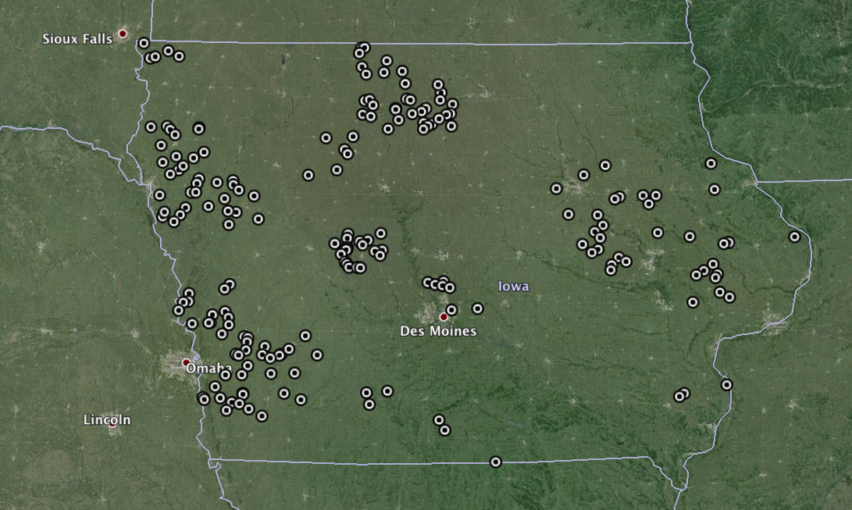
Where is this data from?

Slide 7
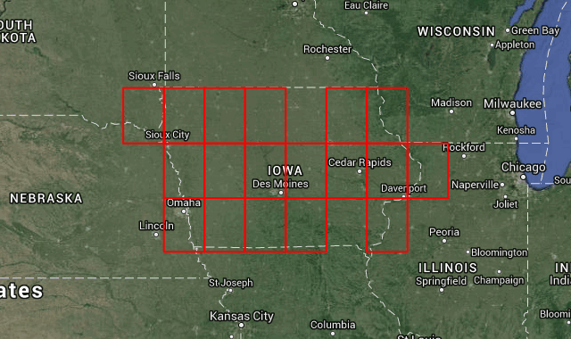
What does 1° latitude / long. look like?

Slide 8
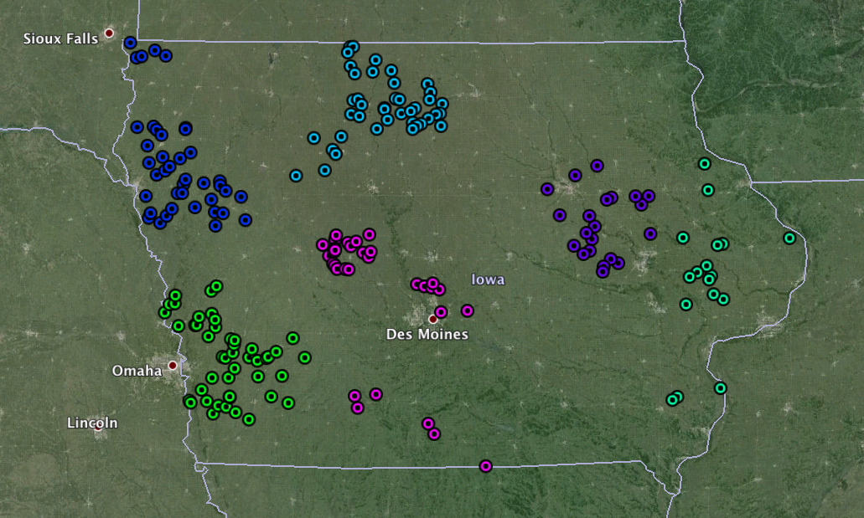
Cluster geographically similar fields

Slide 9
Preliminary Factor Analysis
Input data is predominantly spatial
Desired output is spatial
Weather data has low spatial resolution and variance
Only 51 distinct growing degree day values
Not likely to correlate (spatially) with yield
Might be significant in more geographically diverse dataset
251 unique soil types
7 unique “base” soil types (ignoring series)
Drop soil types that do not map to the soil texture triangle (4242 of 96105 rows)
No crop type indication provided
Could be a critical confounding factor as corn has significantly higher LAI than soybeans (see Viña et al. table 1)
Assigned a guess to each field’s crop type based on mean LAI
Soybeans if mean LAI < 3, else corn

Slide 10
Mixed categorical and scalar inputs
Three choices for handling categorical inputs (soil type, crop type)
1. Train separate models for each discrete value combination
2. Replace with m – 1 dichotomous variables (“dummy coding”)
For example, if we had three soil types:
 |  | Soil Type
 |  | Loam | Sand | Clay
DV | DV1 | 0 | 0 | 1
 | DV2 | 0 | 1 | 1

Slide 11
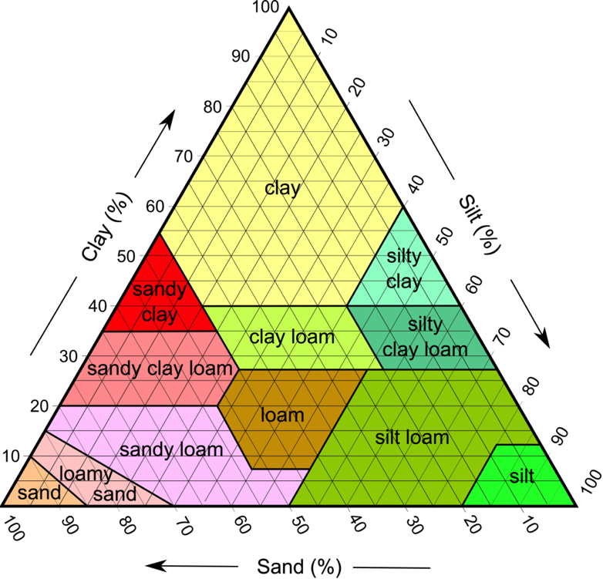
Mixed categorical and scalar inputs
3. Replace with scalar variables
Soil composition via soil texture triangle

Slide 12
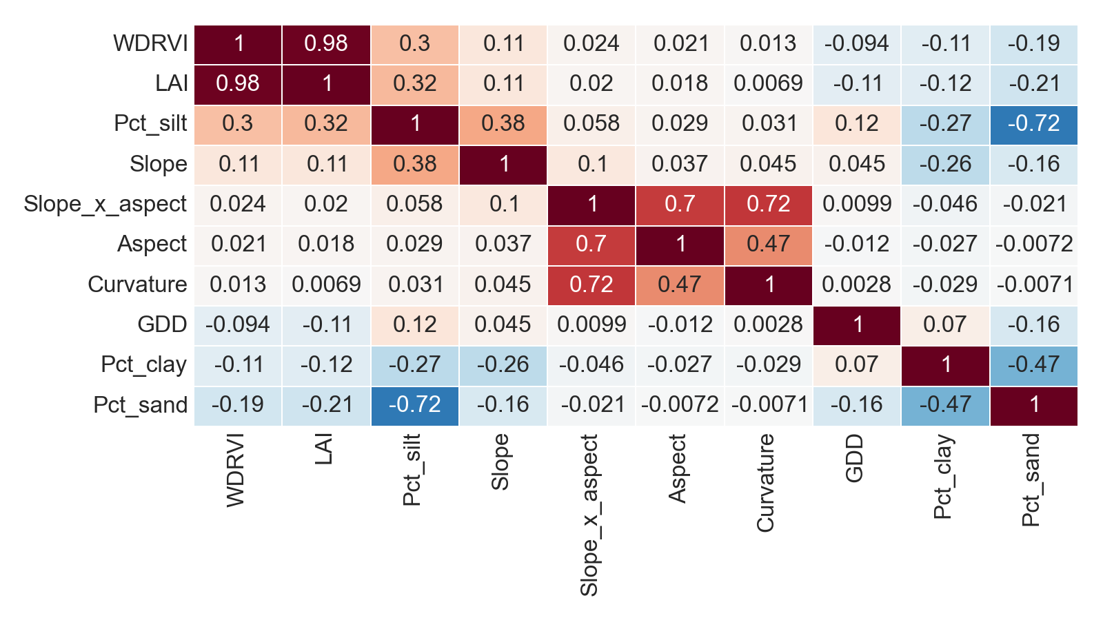
Correlation Matrix (Pearson’s r)

Slide 13
Management zone algorithm
Use model to predict LAI for each unit
Threshold units into low, medium or high productivity:
Low: below 25th percentile
Med: between 25th and 75th percentile
High: above 75th percentile
Apply mode filter to each pixel:
Replace each value by the most common value in a NxN neighborhood

Slide 14
Leaf Area Index Model Details
Lots of choices
Linear vs. non-linear, parametric vs. non-parametric
Opted for simplicity
Linear regression with RANSAC
Robust to outliers
Model inputs
Scalar:
Slope
Slope times aspect
Curvature
Growing degree days
Soil composition: pct sand / silt / clay
Categorical:
Soil type
Geographic cluster
Crop guess (might be cheating)

Slide 15
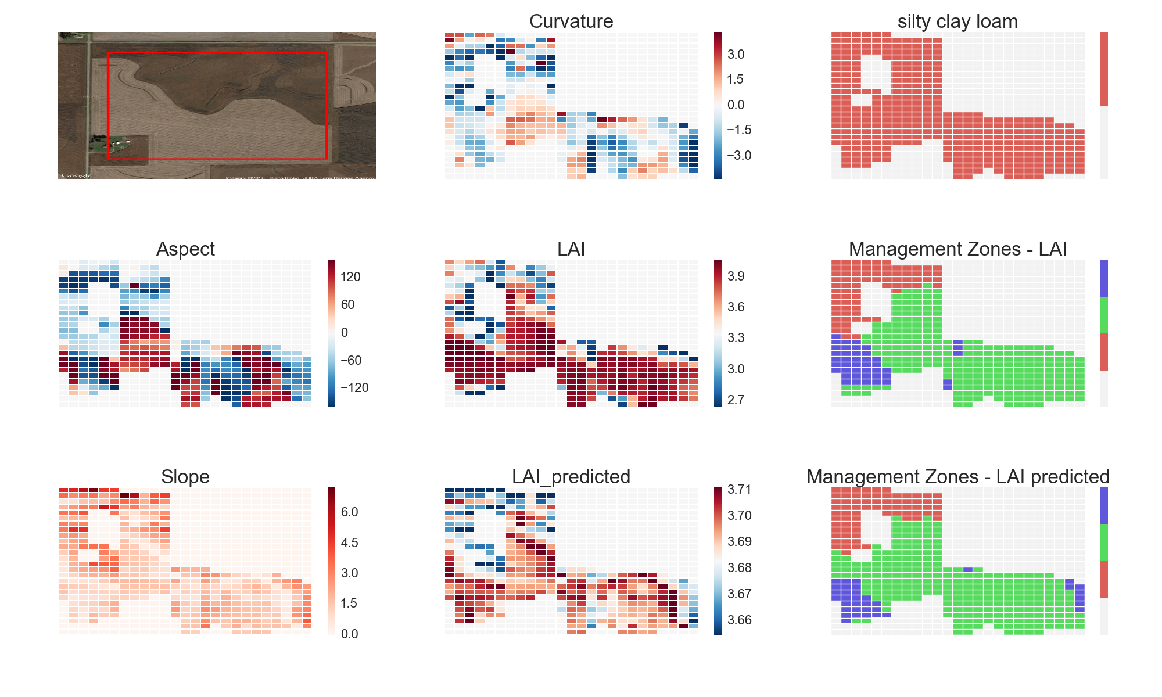
Example Output – Field 125

Slide 16
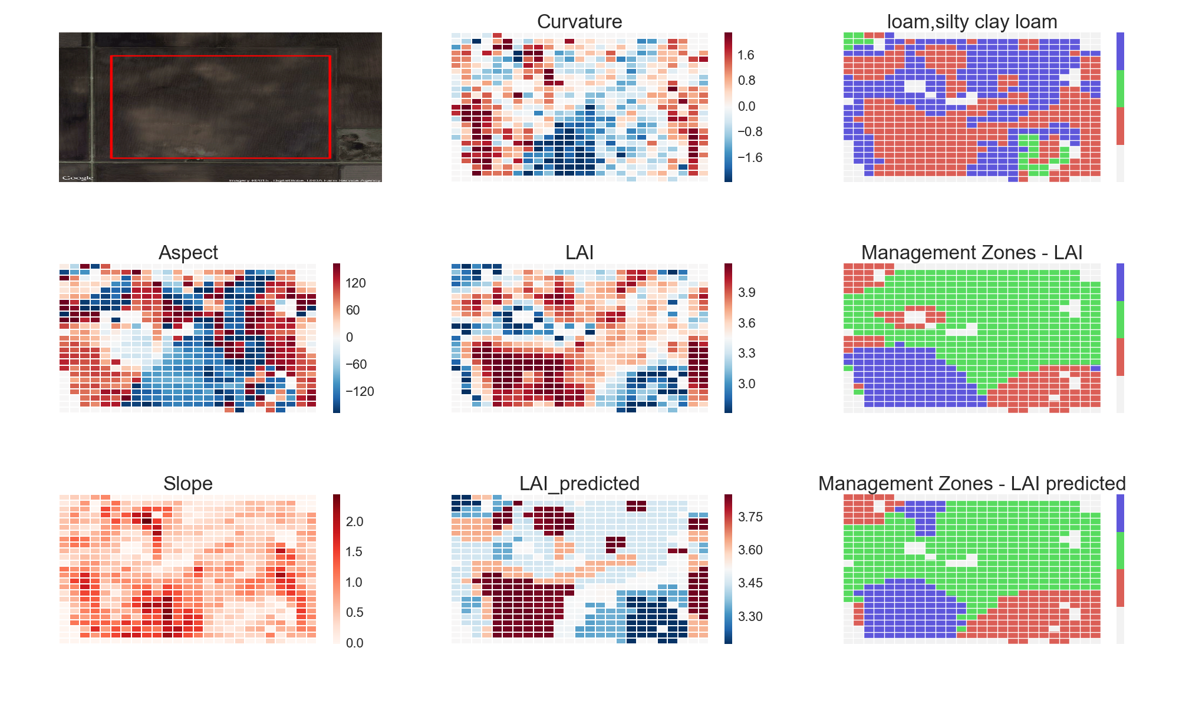
Example Output – Field 138

Slide 17
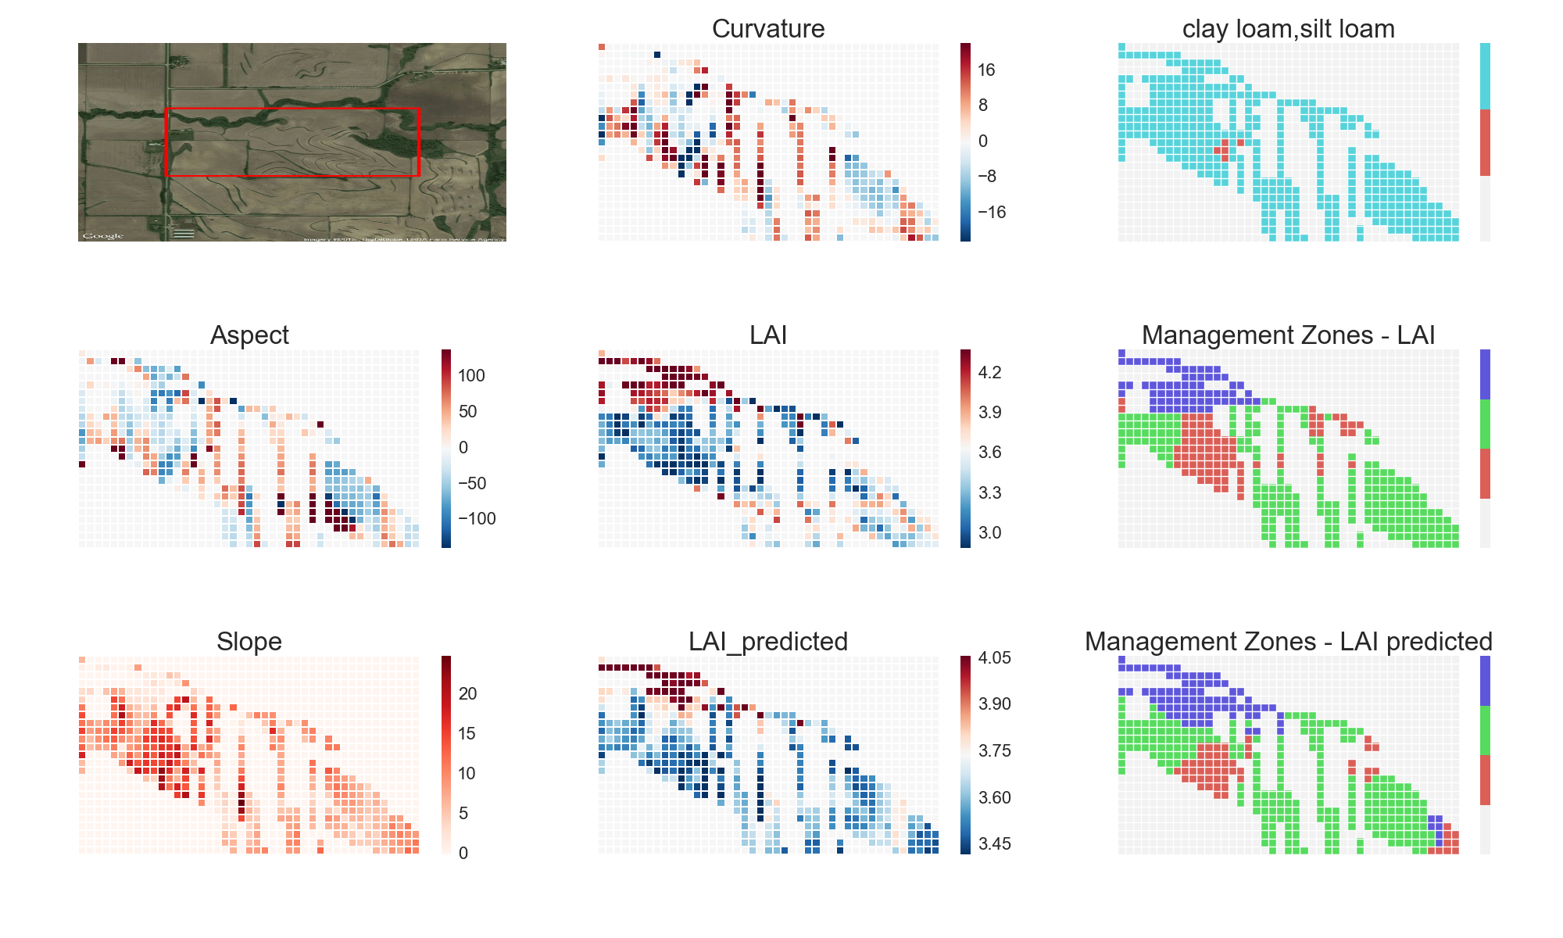
Example Output – Field 73

Slide 18
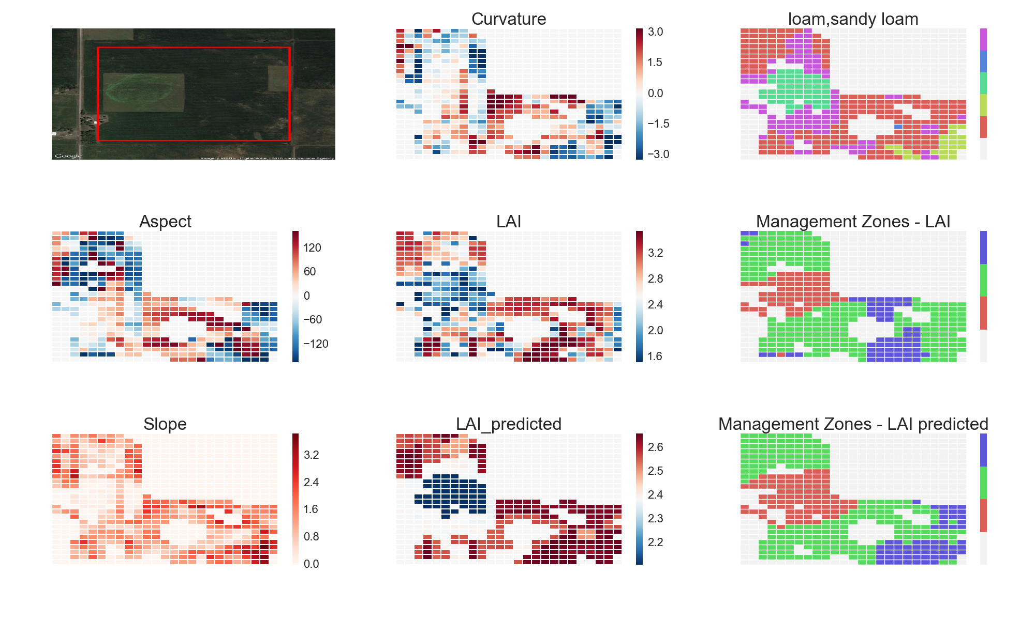
Example Output – Field 61

Slide 19
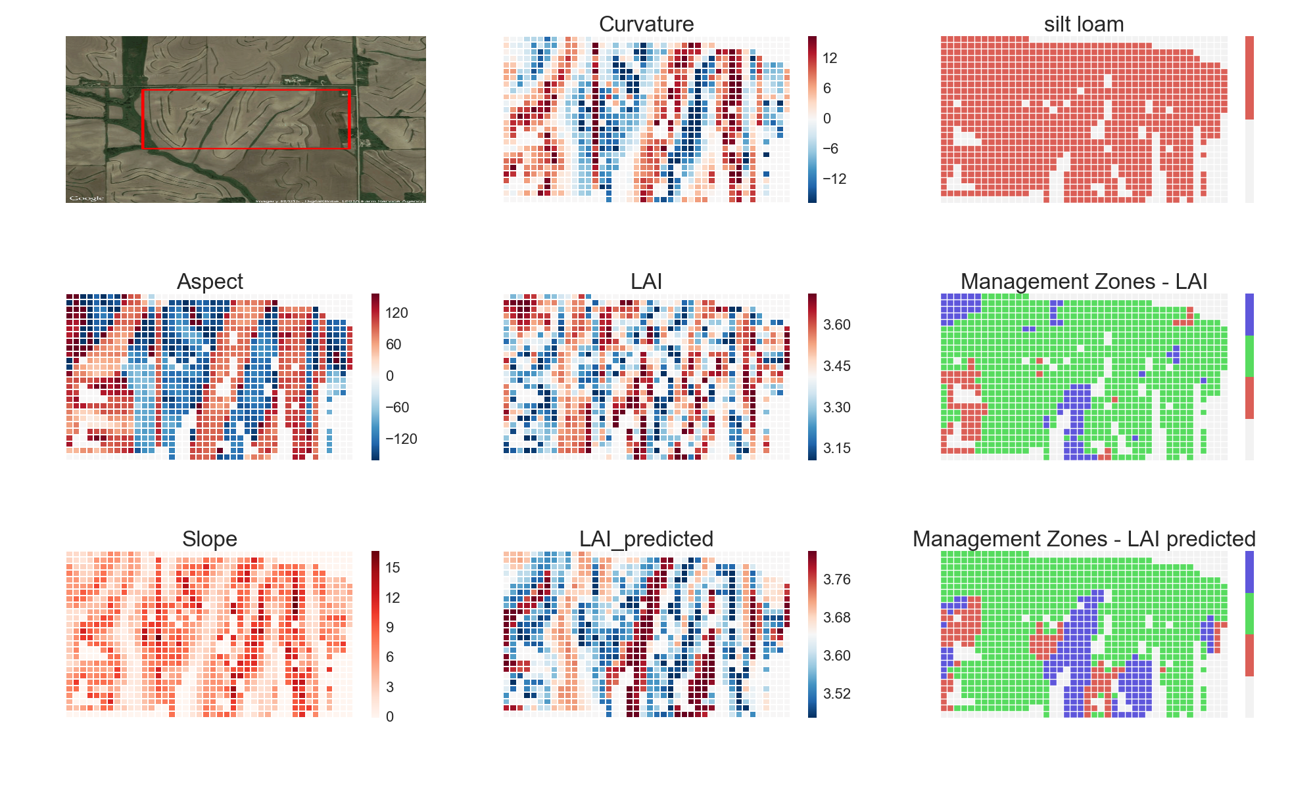
Example Output – Field 114

Slide 20
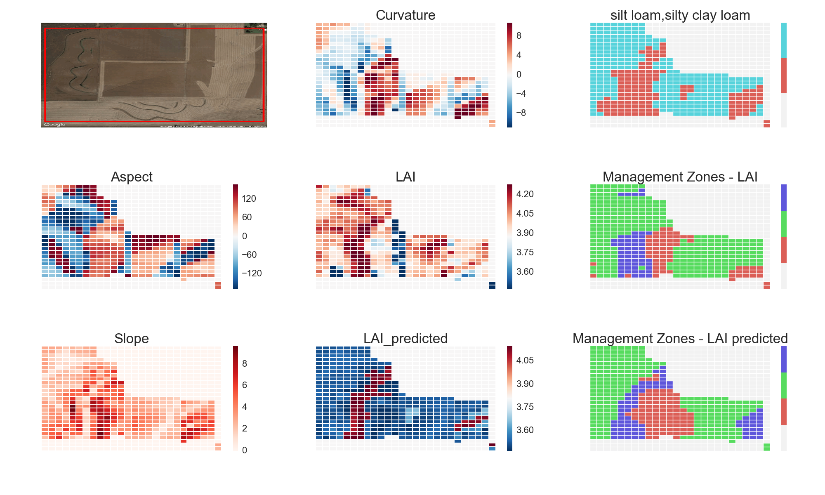
Example Output – Field 105

Slide 21
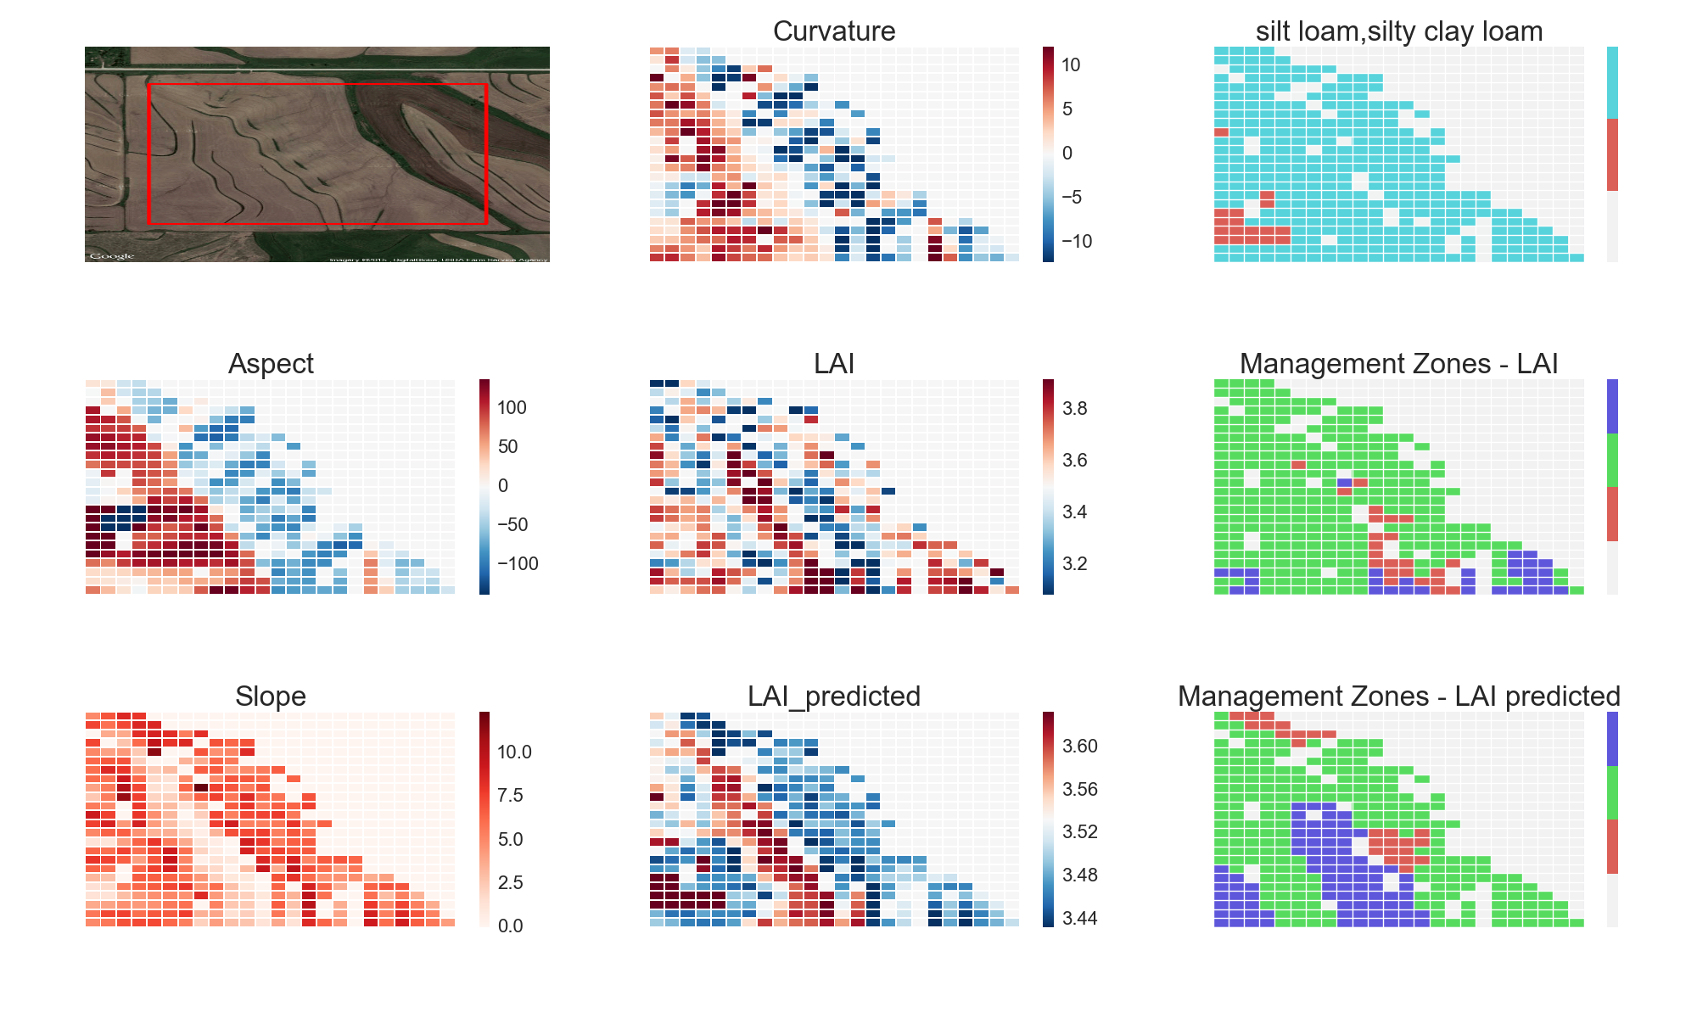
Example Output – Field 64

Slide 22
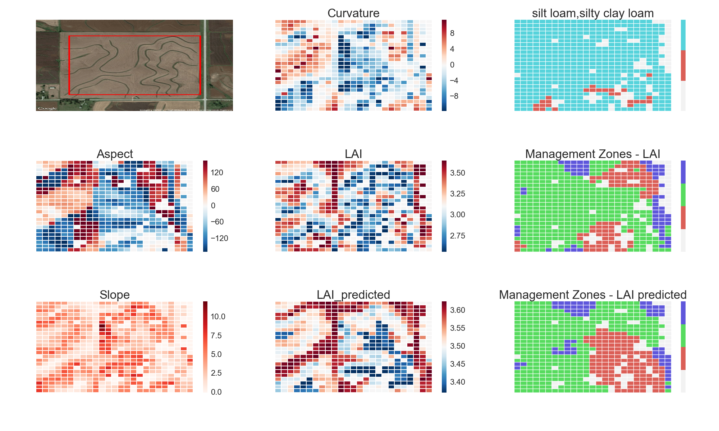
Example Output – Field 181

Slide 23
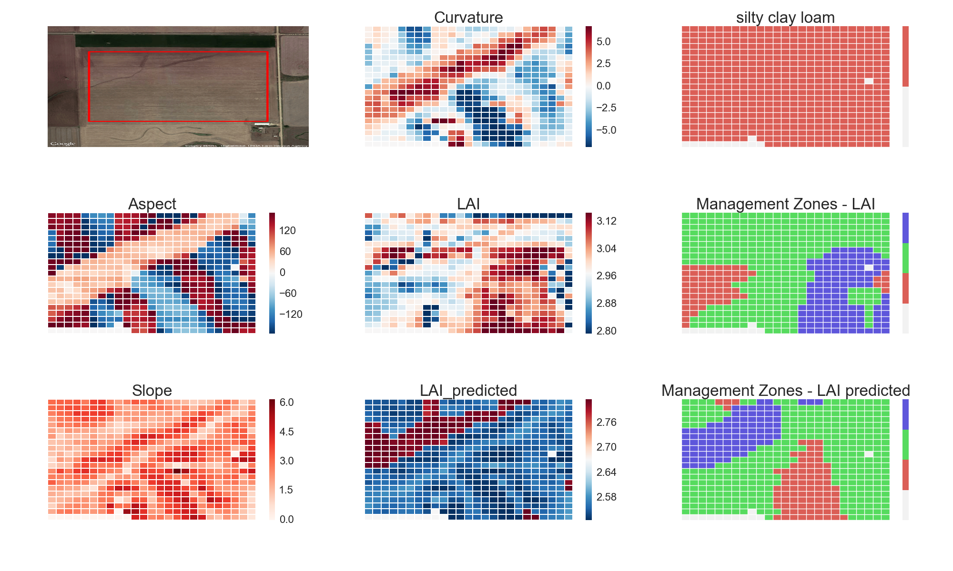
Example Output – Field 171

Slide 24
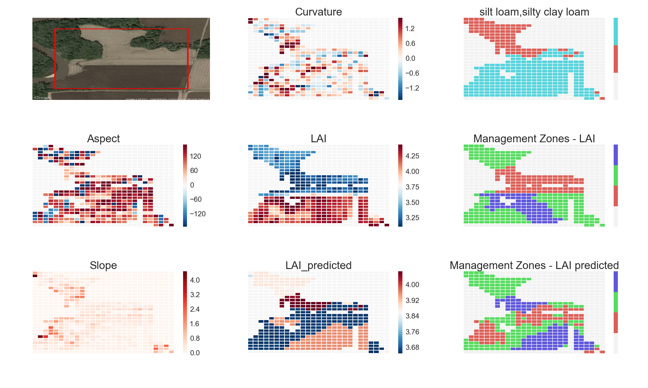
Example Output – Field 3

Slide 25
Validation
Compare management zones generated via estimated LAI to those generated using measured WDRVI/LAI
See how often the two approaches agree
Hope we did better than chance

Slide 26
Expected Result - Chance
 |  |  | Zones estimated via independent RV
 |  |  | Low | Medium | High
 |  | Marginal Dist. | 0.25 | 0.5 | 0.25
Zones estimated via LAI | Low | 0.25 | 0.0625 | 0.125 | 0.0625
 | Med | 0.5 | 0.125 | 0.25 | 0.125
 | High | 0.25 | 0.0625 | 0.125 | 0.0625
 |  | Pct. Agree | 0.25 | 0.5 | 0.25
 |  | Avg. | 0.375

Slide 27
Achieved Result
 |  |  | Zones estimated via estimated LAI
 |  |  | Low | Medium | High
 |  | Marginal Dist. | 0.25 | 0.5 | 0.25
Zones estimated via LAI | Low | 0.25 | 0.049 | 0.096 | 0.019
 | Med | 0.5 | 0.118 | 0.438 | 0.090
 | High | 0.25 | 0.027 | 0.122 | 0.040
 |  | Pct. Agree | 0.250 | 0.668 | 0.266
 |  | Avg. | 0.526

Slide 28
Significance of Result
Somewhat better than chance
Improvement almost exclusively for medium zone
Statistically significant
p << 0.001
Average agreement comparable to results described in Khosla, et al.

Slide 29
Confidence
ZERO
This is a complex problem that can’t properly addressed in the given timeframe
Parameter influence derived via snapshot yield maps
“Most researchers who have used yield maps as a data layer for management zone delineation have concluded that yield maps alone are not a suitable basis for delineating zones, primarily because yield patterns are inconsistent between growing seasons” - Khosla
Percentiles within a given field aren’t meaningful if the range of differences is small
Can drive performance to 100% agreement by pushing out definitions of low / high productivity
E.g., ‘low’ < 1st percentile, ‘high’ > 99th, etc

Slide 30
Next Steps
Discuss with domain experts
Get better understanding of available data sources
Mine soil type series characteristics
Drainage, permeability, etc.
https://soilseries.sc.egov.usda.gov/OSD_Docs/A/ALBATON.html

